Slide 1
JavaScript Frameworks

Slide 2
Outline
Node.js
Angular.js
Vue.js

Slide 3

Node.js
Node.js is a JavaScript runtime built on Chrome's V8 JavaScript engine.
Node.js uses an event-driven, non-blocking I/O model that makes it lightweight and efficient.
Node.js allows the creation of Web servers and networking tools using JavaScript and a collection of "modules" that handle various core functionality.
Modules handle file system I/O, networking (DNS, HTTP, TCP, TLS/SSL, or UDP), binary data (buffers), cryptography functions, data streams and other core functions.

Slide 4
Basic functionality
HTTP
To use the HTTP server and client one must require('http').
The HTTP interfaces in Node.js are designed to support many features of the protocol which have been traditionally difficult to use. In particular, large, possibly chunk-encoded, messages. The interface is careful to never buffer entire requests or responses--the user is able to stream data.
http.createServer([requestListener])
Returns a new instance of http.Server.
The requestListener is a function which is automatically added to the 'request' event.
http.request(options[, callback])
Node.js maintains several connections per server to make HTTP requests. This function allows one to transparently issue requests.
options can be an object or a string. If options is a string, it is automatically parsed with url.parse().
http.get(options[, callback])
Since most requests are GET requests without bodies, Node.js provides this convenience method. The only difference between this method and http.request() is that it sets the method to GET and calls req.end() automatically.

Slide 5
Basic functionality
File System
File I/O is provided by simple wrappers around standard POSIX functions. To use this module do require('fs'). All the methods have asynchronous and synchronous forms..
fs.readFile(file[, options], callback)
Asynchronously reads the entire contents of a file.
The callback is passed two arguments (err, data), where data is the contents of the file.
If no encoding is specified, then the raw buffer is returned.
fs.readFileSync(file[, options])
Synchronous version of fs.readFile. Returns the contents of the file.
If the encoding option is specified then this function returns a string. Otherwise it returns a buffer.
.

Slide 6
Basic functionality
Buffer
Prior to the introduction of TypedArray in ECMAScript 2015 (ES6), the JavaScript language had no mechanism for reading or manipulating streams of binary data. The Buffer class was introduced as part of the Node.js API to make it possible to interact with octet streams in the context of things like TCP streams and file system operations.
The Buffer class is a global within Node.js, making it unlikely that one would need to ever use require('buffer').
Buffers and Character Encodings
Buffers are commonly used to represent sequences of encoded characters such as UTF8, UCS2, Base64 or even Hex-encoded data. It is possible to convert back and forth between Buffers and ordinary JavaScript string objects by using an explicit encoding method.

Slide 7
Example usage – Buffer Class
buffer.js:
const buf = new Buffer('hello world', 'ascii');
console.log(buf.toString('hex'));
// prints: 68656c6c6f20776f726c64
console.log(buf.toString('base64'));
// prints: aGVsbG8gd29ybGQ=

Slide 8
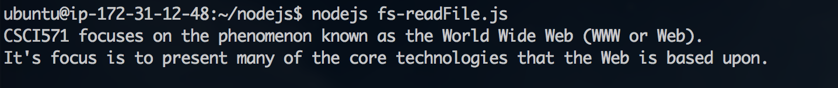
Example usage – Read File
fs-readFile.js:
var fs = require('fs');
fs.readFile('./intro.txt', function (err, data) {
if (err) throw err;
console.log(data);
});
Intro.txt:
JsApp.US is a hosting platform for node.js applications.
It is setup to be a platform to coddle to quick, weekend hack like projects.
Run command:
$ nodejs fs-readFile.js

Slide 9
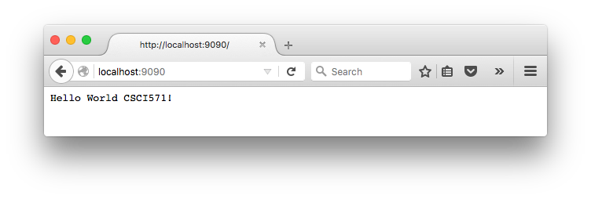
Example usage – Run Web Server
server.js:
const http = require('http');
http.createServer(function (req, res) {
res.writeHead(200, { 'Content-Type': 'text/plain' });
res.end('Hello World CSCI571!\n');
}).listen(9090, '127.0.0.1', function () {
console.log(`Server running at http://localhost:9090/`);});
Run command:
$ sudo node server.js

Slide 10
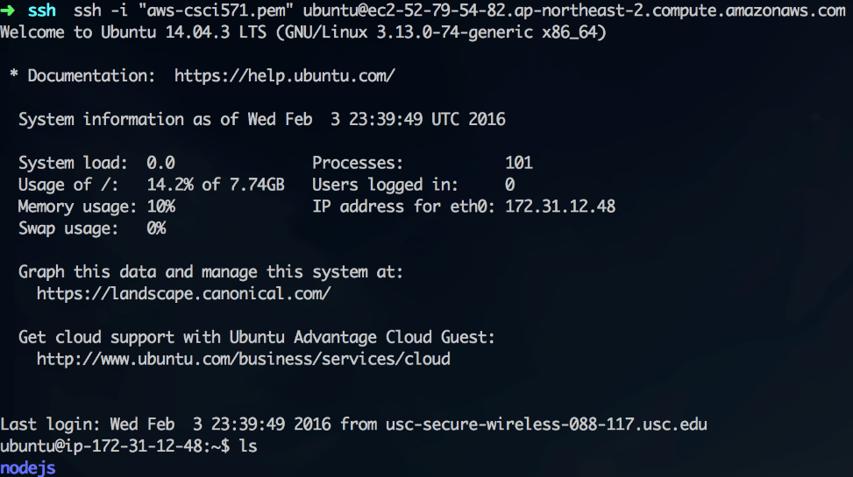
Node.js on AWS
Create Ubuntu Micro EC32 instance
ssh to the AWS ubuntu server
Download node.js using ‘wget’
Execute the binaries, make, and install via the command:
./configure && make && sudo make install

Slide 11
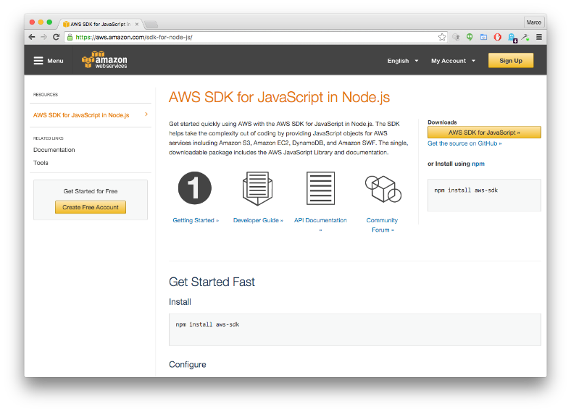
Node.js on AWS
AWS SDK for JavaScript in Node.js
Provides JavaScript objects for AWS services including Amazon S3, Amazon EC2, DynamoDB, Amazon Elastic Beanstalk and many more.
Single, downloadable package includes the AWS JavaScript Library and documentation
See: https://aws.amazon.com/sdk-for-node-js/

Slide 12
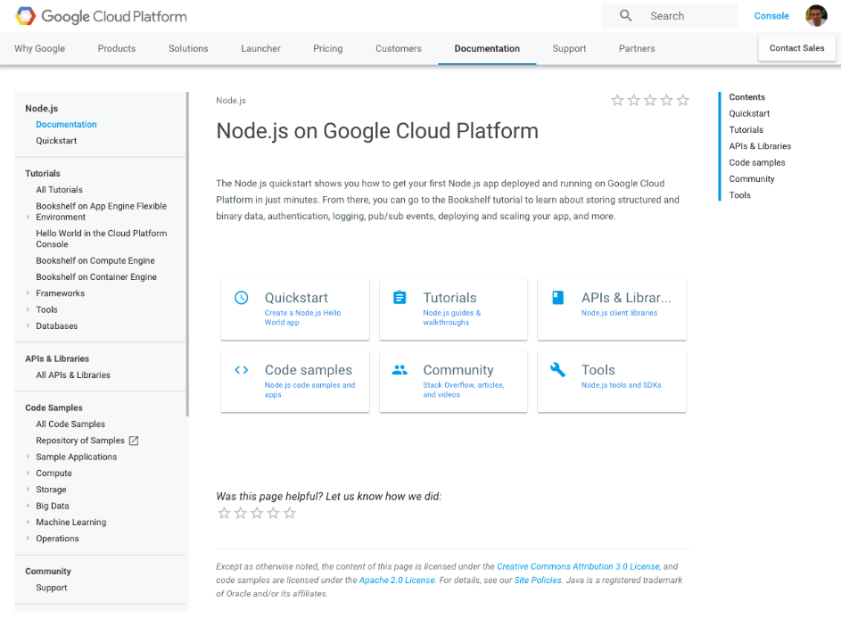
Node.js on Google Cloud Platform
Node.js app deployed using Google App Engine Managed VMs
Scales to serve millions of requests
Supports structures and binary data, authentication, logging, events
See: https://cloud.google.com/nodejs

Slide 13
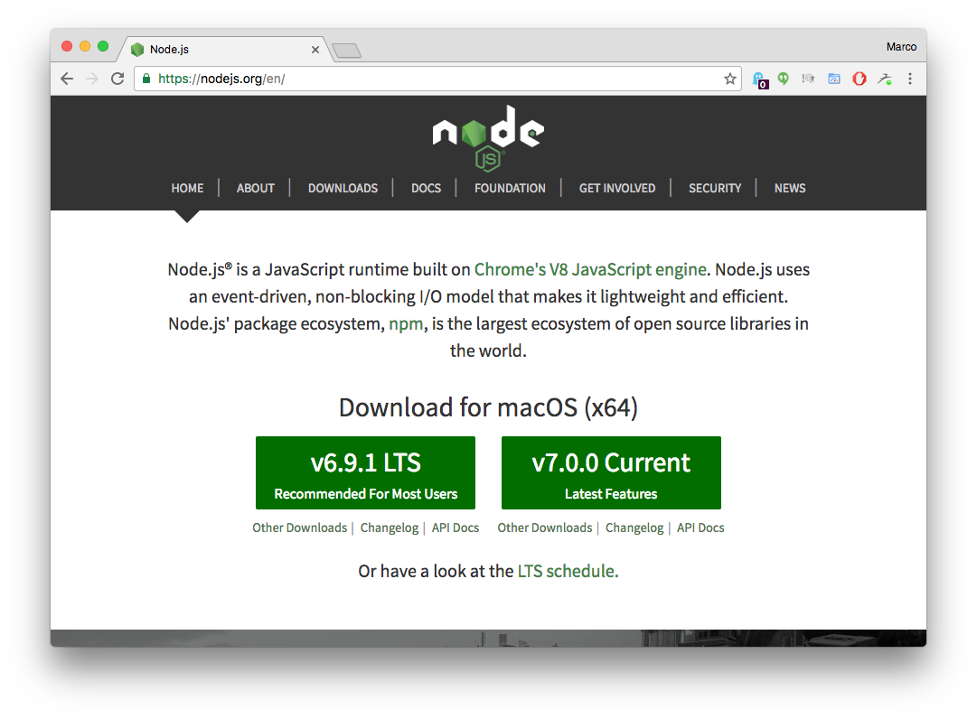
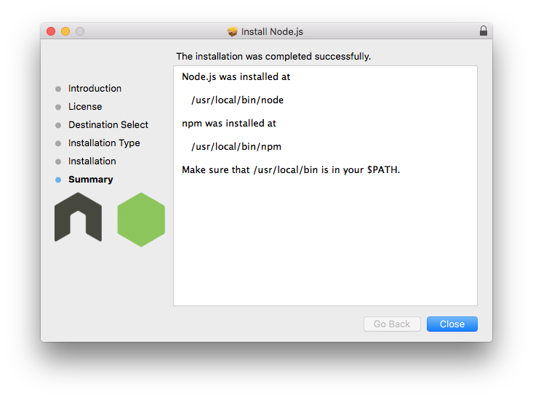
Node.js on OS X and Windows
Download OS X package at https://nodejs.org/en/
Learn Node.js on you local MacBook or Windows PC
Latest version is 7.0

Slide 14
Related URLs
Node.js website: https://nodejs.org/
Node.js on Github: https://github.com/nodejs/node
NPM: https://www.npmjs.com/
Learn Node.js in terminal: https://github.com/workshopper/learnyounode
Tools:
http://expressjs.com/
http://gruntjs.com/

Slide 15

Angular.js
Why AngularJS?
HTML is great for declaring static documents, but it falters when we try to use it for declaring dynamic views in web-applications. AngularJS lets you extend HTML vocabulary for your application. The resulting environment is extraordinarily expressive, readable, and quick to develop.
Alternatives
Other frameworks deal with HTML’s shortcomings by either abstracting away HTML, CSS, and/or JavaScript or by providing an imperative way for manipulating the DOM. Neither of these address the root problem that HTML was not designed for dynamic views.
Extensibility
AngularJS is a toolset for building the framework most suited to your application development. It is fully extensible and works well with other libraries. Every feature can be modified or replaced to suit your unique development workflow and feature needs. Read on to find out how.

Slide 16
Basic functionality
Control of the app
Data Binding
Data-binding is an automatic way of updating the view whenever the model changes, as well as updating the model whenever the view changes. This is awesome because it eliminates DOM manipulation from the list of things you have to worry about.
Controller
Controllers are the behavior behind the DOM elements. AngularJS lets you express the behavior in a clean readable form without the usual boilerplate of updating the DOM, registering callbacks or watching model changes.
Plain JavaScript
Unlike other frameworks, there is no need to inherit from proprietary types in order to wrap the model in accessors methods. Angular models are plain old JavaScript objects. This makes your code easy to test, maintain, reuse, and again free from boilerplate.

Slide 17
Basic functionality
Wire up a Backend
Deep Linking
A deep link reflects where the user is in the app, this is useful so users can bookmark and email links to locations within apps. Round trip apps get this automatically, but AJAX apps by their nature do not. AngularJS combines the benefits of deep link with desktop app-like behavior.
Form Validation
Client-side form validation is an important part of great user experience. AngularJS lets you declare the validation rules of the form without having to write JavaScript code. Write less code, go have beer sooner.
Server Communication
AngularJS provides built-in services on top of XHR as well as various other backends using third party libraries. Promises further simplify your code by handling asynchronous return of data.

Slide 18
Basic functionality
Create Components
Directives
Directives is a unique and powerful feature available only in Angular. Directives let you invent new HTML syntax, specific to your application.
Reusable Components
We use directives to create reusable components. A component allows you to hide complex DOM structure, CSS, and behavior. This lets you focus either on what the application does or how the application looks separately.
Localization
An important part of serious apps is localization. Angular's locale aware filters and stemming directives give you building blocks to make your application available in all locales.

Slide 19
Introduction
AngularJS is a complete JavaScript-based open-source front-end web application framework.
Its mainly maintained by Google and some community of individuals.
It provides a framework for client-side model–view–controller (MVC) and model–view–viewmodel (MVVM) architectures.
AngularJS is the frontend part of the MEAN stack, consisting of MongoDB database, Express.js web application server framework, Angular.js itself, and Node.js runtime environment.

Slide 20







Companies that Use Angular JS
There are approximately 12,000 other sites out of 1 million tested in October 2016 that use Angular JS
Companies that use Angular JS [1] - http://libscore.com/?#angular

Slide 21
Goals
AngularJS de-emphasizes explicit DOM manipulation with the goal of improving testability and performance.
Design goals are
It decouples DOM manipulation from application logic
It decouple the client side of an application from the server side.
It provides structure for building an application
Designing the UI
Writing the business logic
Testing

Slide 22
Goals (cont’d)
Angular JS framework adapts and extends traditional HTML.
It supports dynamic content through two-way data-binding
Two-way data-binding allows for the automatic synchronization of models and views.
The tasks in angular bootstrapper occur in 3 phases
Creation of a new Injector
Compilation of the directives that decorate the DOM
Linking of all directives to scope

Slide 23
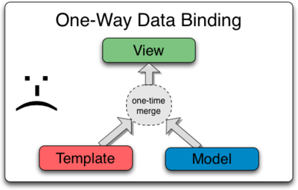
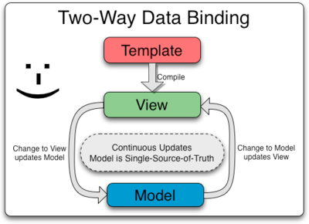
Data Binding
Classical
Angular
Any changes that the user makes to the view are not reflected in the model
The view is just a projection of the model. So there is automatic refresh of the data between view and model

Slide 24
Angular Directives
AngularJS directives allows to specify custom reusable HTML-like elements and attributes.
Some of the Angular Directives are
ng-app
ng-controller
ng-bind
ng-model
ng-class
ng-repeat

Slide 25
Angular Directives (Cont’d)
ng-app
Declares the root element of an AngularJS application.
ng-controller
Specifies a JavaScript controller class that evaluates HTML expressions.
ng-bind
Sets the text of a DOM element to the value of an expression.
ng-model
Similar to ng-bind, but establishes a two-way data binding between the view and the scope.
ng-repeat
Instantiate an element once per item from a collection.

Slide 26
Code Snippet – Angular Instantiation
<script>
var app = angular.module(“myApp", []);
app.controller(“myController", function($scope,$http) {
// $scope holds your model (metadata) for your application
$scope.topic = “CSCI 571”;
});
</script>
<body ng-app=“myApp" ng-controller=“myController">
</body>
An AngularJS module defines an application.
The module is a container for controllers
Controllers always belong to a module.

Slide 27
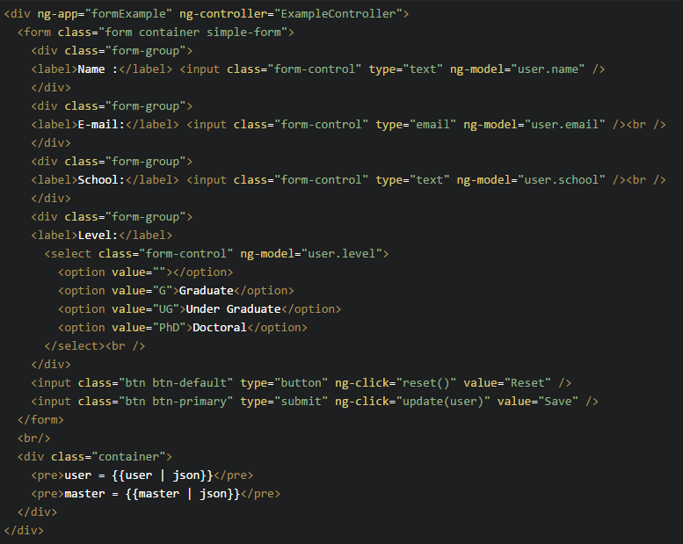
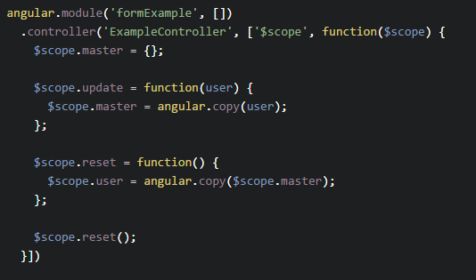
Angular Module - Example
A simple example which shows how angular JS process model.

Slide 28
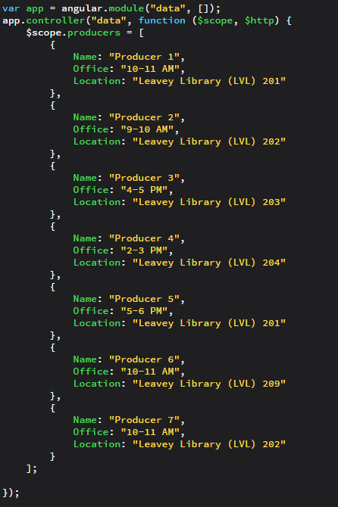
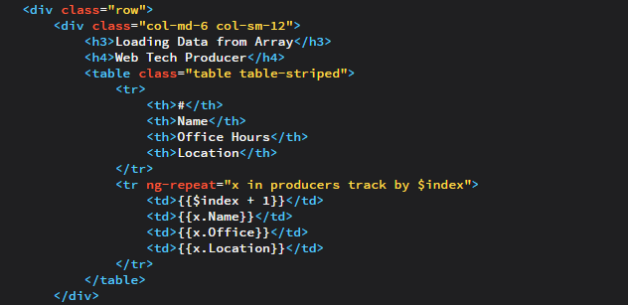
Angular Repeat with data from static array
ng-repeat works like a for loop and replicates the template to the number of rows in the model

Slide 29
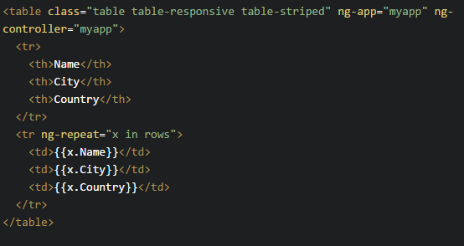
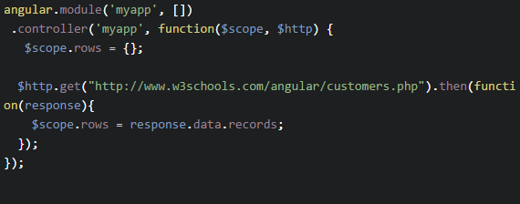
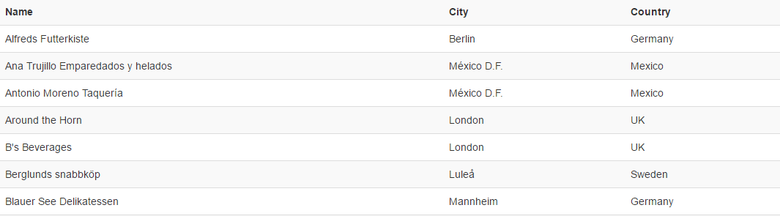
Angular Repeat from external source
$http holds the xml http request handler in Angular.

Slide 30
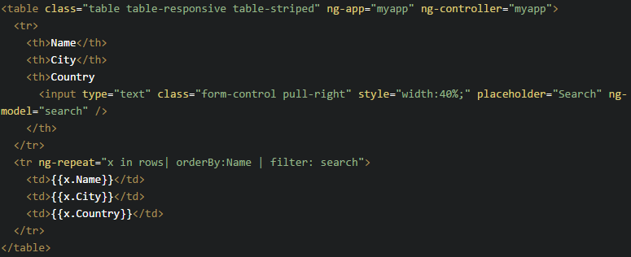
Angular Sort and Search
orderBy: sort the Column ascending
orderBy:<column>:<reverse>
<column> - the column you want to sort
<reverse> - true-descending, false-ascending
Filter: search the rows in the model
Filter:<searchstring> e.x. filter: search
Or
Filter:<column_based_search> e.x. filter:{<column>:search}

Slide 31
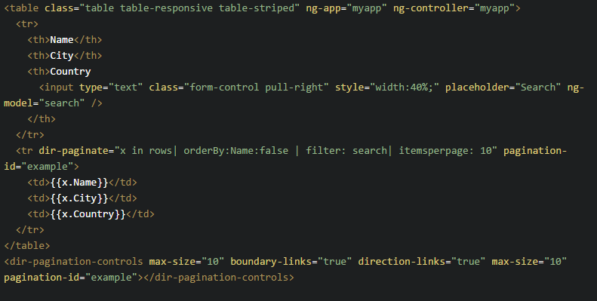
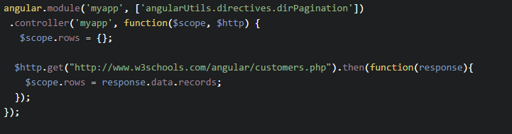
Angular External UI Components
External components need to be added to the angular application.
angular.module(‘myapp’, [<external_components>])

Slide 32
Example usage & Related URLs
Examples
Hello World: https://angularjs.org/#the-basics
Todo List: https://angularjs.org/#add-some-control
Advanced Single Page App: https://angularjs.org/#wire-up-a-backend
Related URLs
Angular.js website: https://angularjs.org
Angular.js on Github: https://github.com/angular/angular.js
Tutorial: https://docs.angularjs.org/tutorial
Angular.js Course
http://campus.codeschool.com/courses/shaping-up-with-angular-js/level/1/section/1/creating-a-store-module
Angular 2 (In beta): https://angular.io/

Slide 33

Vue.js
Vue.js is a library for building interactive web interfaces.
Vue.js is focused on the ViewModel layer of the MVVM pattern.
It connects the View and the Model via two way data bindings.
Actual DOM manipulations and output formatting are abstracted away into Directives and Filters.
Vue.js’ API is heavily influenced by AngularJS, KnockoutJS, Ractive.js and Rivets.js.
Vue.js

Slide 34
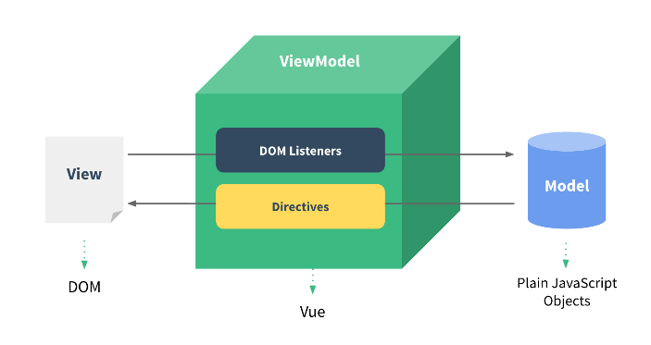
Basic functionality
ViewModel
An object that syncs the Model and the View. In Vue.js, every Vue instance is a ViewModel.
var vm = new Vue({ /* options */ })
View
The actual DOM that is managed by Vue instances.
Vue.js uses DOM-based templating. Each Vue instance is associated with a corresponding DOM element. When a Vue instance is created, it recursively walks all child nodes of its root element while setting up the necessary data bindings. After the View is compiled, it becomes reactive to data changes.el // The View

Slide 35
Basic functionality
Model
A slightly modified plain JavaScript object.
In Vue.js, models are simply plain JavaScript objects, or data objects. Once an object is used as data inside a Vue instance, it becomes reactive. You can manipulate their properties and Vue instances that are observing them will be notified of the changes. Vue.js achieves transparent reactivity by converting the properties on data objects into ES5 getter/setters. There’s no need for dirty checking, nor do you have to explicitly signal Vue to update the View. Whenever the data changes, the View is updated on the next frame.
Directives
Prefixed HTML attributes that tell Vue.js to do something about a DOM element.
<div v-text="message"></div>
Here the div element has a v-text directive with the value message. This tells Vue.js to keep the div’s textContent in sync with the Vue instance’s message property.

Slide 36
Basic functionality
Filters
Filters are functions used to process the raw values before updating the View. They are denoted by a “pipe” inside directives or bindings:
<div>{{message | capitalize}}</div>
Now before the div’s textContent is updated, the message value will first be passed through the capitalize function.
Components
In Vue.js, every component is simply a Vue instance.
Components form a nested tree-like hierarchy that represents your application interface. They can be instantiated by a custom constructor returned from Vue.extend, but a more declarative approach is registering them with Vue.component(id, constructor). Once registered, they can be declaratively nested in other Vue instance’s templates in the form of custom elements.

Slide 37
Example usage & Related URLs
Examples
Markdown Editor: http://vuejs.org/examples/
Grid Component: http://vuejs.org/examples/grid-component.html
Tree View: http://vuejs.org/examples/tree-view.html
TodoMVC: http://vuejs.org/examples/todomvc.html
HackerNews Clone: http://vuejs.org/examples/hackernews.html
Related URLs
Vue.js Website: http://vuejs.org/
Vue.js on Github: https://github.com/vuejs/vue/
Forum: http://forum.vuejs.org/
Showcases: https://github.com/vuejs/awesome-vue
Vue-router: https://github.com/vuejs/vue-router

